Slide 1
Lecture 3. Molecular-kinetic properties of disperse systems.
Brownian motion.
Diffusion.
Sedimentation of coarse disperse systems.
Colligative properties are stipulated by quantity of kinetic units, i.e amount of molecules per unit of volume or weight and they
do not depend on nature of solute particles.
Colligative properties include osmosis, diffusion, depression in freezing point and elevation in boiling point.

Slide 2
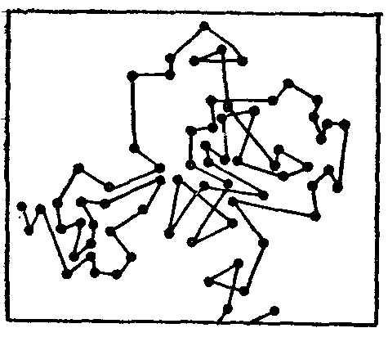
Brownian Motion
There are continuous collisions between the colloidal particles and molecules of dispersion medium which are in constant motion and passes kinetic energy to colloidal particles by striking it from all sides.
This results into zigzag movement of colloidal particles. This zigzag movement of colloidal particles is known as Brownian motion (first described by botanist R. Brownian in 1827).
Brownian motion: the random movement of particles suspended in a liquid or gas, caused by collisions with molecules of the surrounding medium.
A.Einstein and M.Smoluchowski in 1905, theorized that the random movements of a particle undergoing Brownian motion could be completely explained by molecular-kinetic theory.

Slide 3
Video about Brownian Motion conception

Slide 4
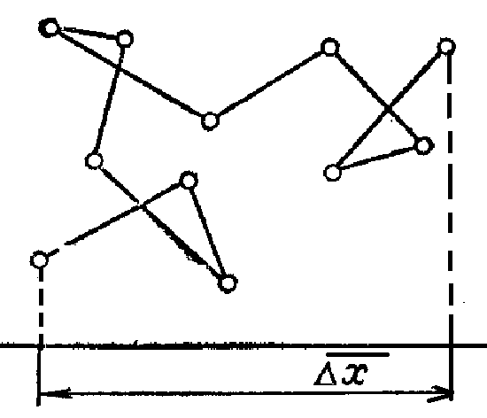
Δ X - displacement of the particle during some time interval Δt
Average square displacement of particle as a suitable characteristic by Einstein
Brownian motion theory gave novel independent way of Avogadro ‘s number.
Such measurements carried out by J.Perrin with different suspensions And showed that colloid particles posses thermal motion. Why T.Graham and other scientists were not able to establish the existence of osmotic pressure and diffusion in colloidal solutions?

Slide 5
Diffusion
If we consider the distribution of substance of known concentration C in contact with the pure medium C₀. The transfer of substance will proceed till equable distribution in medium. Diffusion proceeds according to Fick’s first law:
where n- amount of substance defunded ,mol; D –diffusion coefficient, m²/s; dc/dx – concentration gradient, mol/m⁴; S –section of unit area through one substance crosses, m²; τ - time, s.

Slide 6
D=10⁻⁵ cm²/s – for molecules and ions
D=10⁻⁷⁻⁻ 10⁻⁹ cm²/s – for colloidal particles
If D=5∙10⁻⁹ cm² /s, the diffusion time of 1 cm takes 3 year, for molecules – a few hours.

Slide 7
Video about Osmosis phenomenon

Slide 8
Osmosis
In ideal systems the osmotic preasure, π
π = с⋅R⋅T Van’t Hoff low
In true solution: If c=1M, π=22,4 atm (2,27 MPa)
For colloidal solution ( 0,1% of Au sol of the сube shape)
l = 10⁻⁶ cm, particle volume V=l³ = 10⁻¹⁸ cm³
Particle weight :
m=Vd=20X10⁻¹⁸ = 2x 10⁻¹⁷ g
c_{d} = ν/N, ν – particle concentration
1 g particle in 1 litre (for 0,1 %),
c_{d} = 1/(2x 10⁻¹⁷ 6X 10²³ )≈ 10⁻⁷ g particle/l
π=22,4 x10⁻⁷ atm (0,227 Pа)

Slide 9
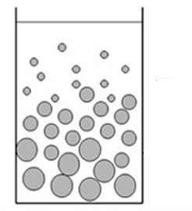
Sedimentation
Sedimentation of coarse disperse systems
Stock’s equation
Phygorovski method
Sedimentation diffusion equilibrium
$$υ = \frac{2}{9} r^{2}\frac{\left(ρ− ρ_{0})g\right.}{η}$$

Slide 10
Questions?
Thank you for your attention!

